Slide 1
Appropriate experimental ecosystem warming methods by ecosystem objective, and practicality
By: Emma L. Arnonson, Stevan G. McNulty

Slide 2
Warming effects on ecosystem
Change in ecosystem productivity,
Change in plant water use and nutrients demands
Increase the insects, disease outbreak
Increase fire occurrence and fire damage
Shifts plant, animal and microbial distribution
Biogeochemical cycles
Affects ecosystem functions and processes.

Slide 3
Importance of warming experiments
Simulate global warming
Study ecosystem response to global warming
Global change prediction
Climate models

Slide 4
Warming methods
Basis for comparison:
Method complexity
Ecosystem applicability limits
Replication of natural heating level
Ecosystem disturbance

Slide 5
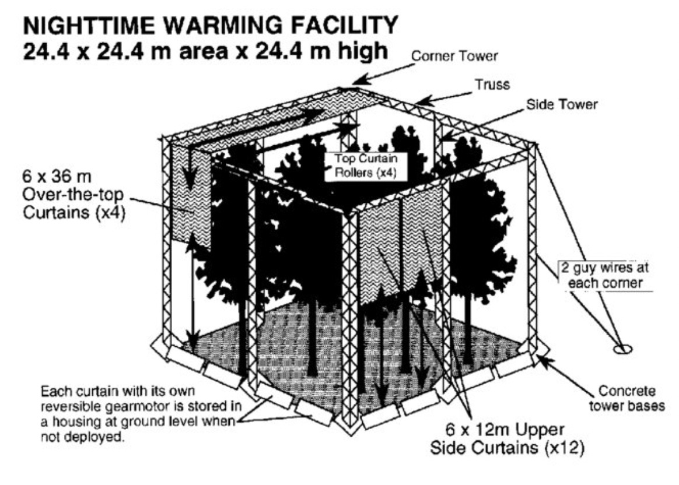
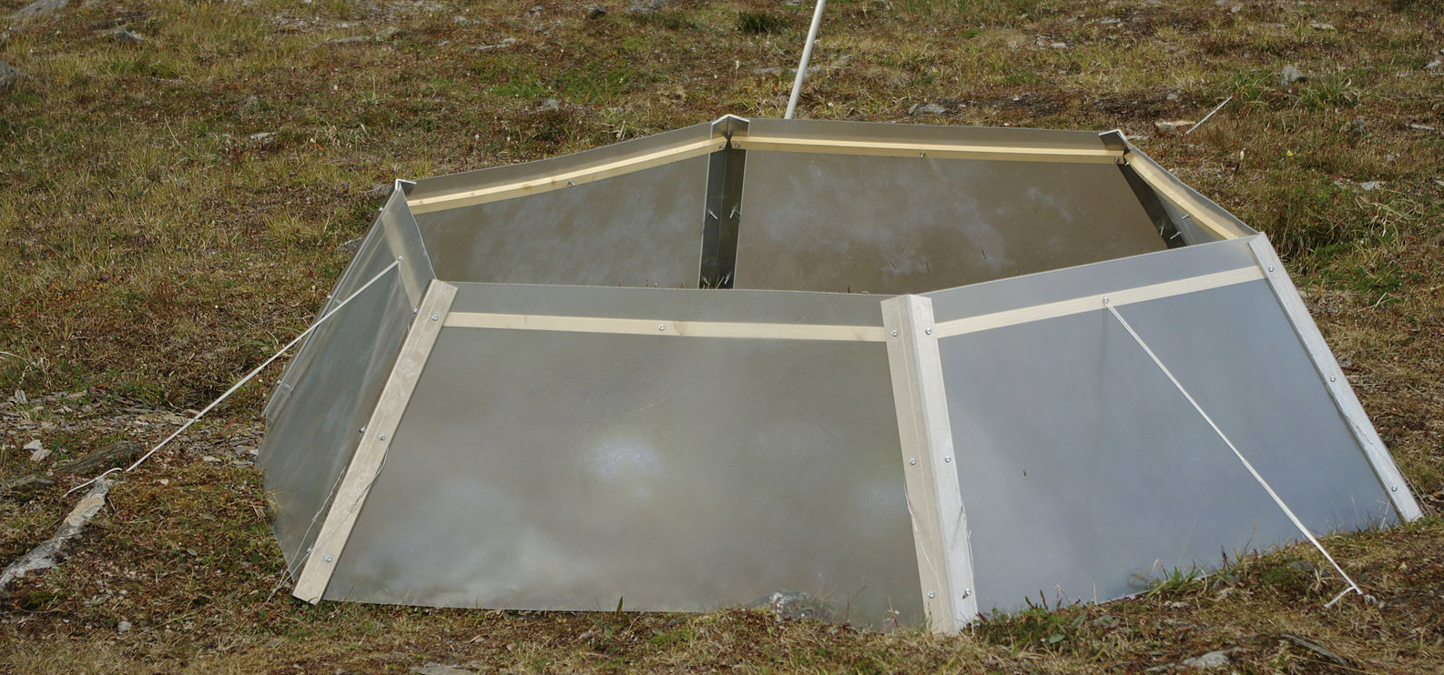
Passive warming methods
Passive night-time warming
Field chambers
Field style greenhouses
Tents
Open top Chamber (OTC)

Slide 6
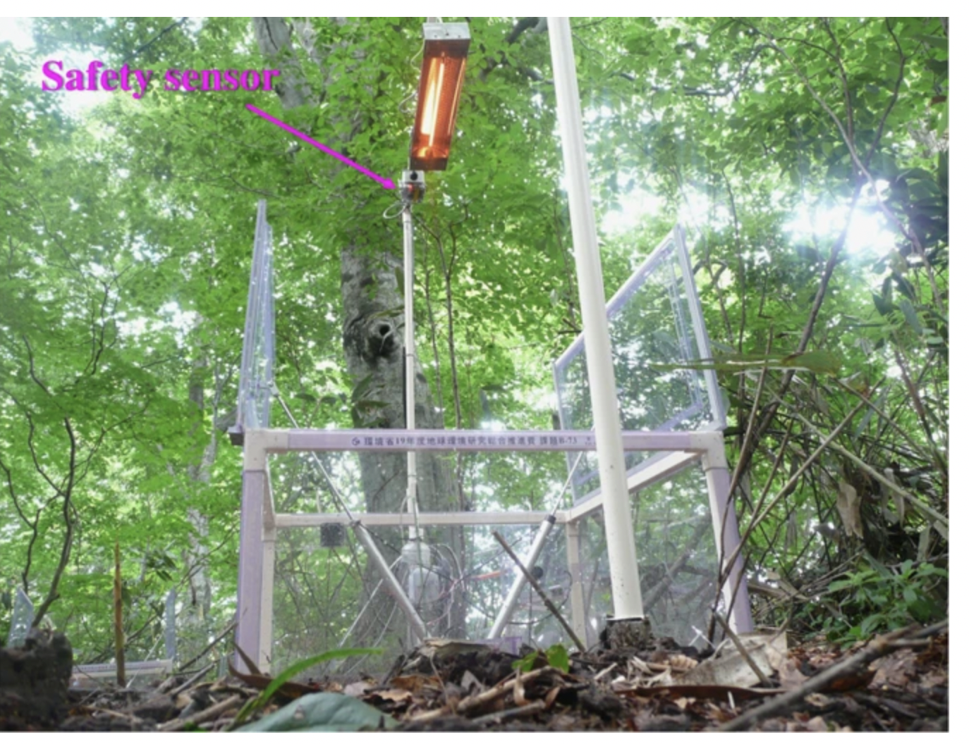
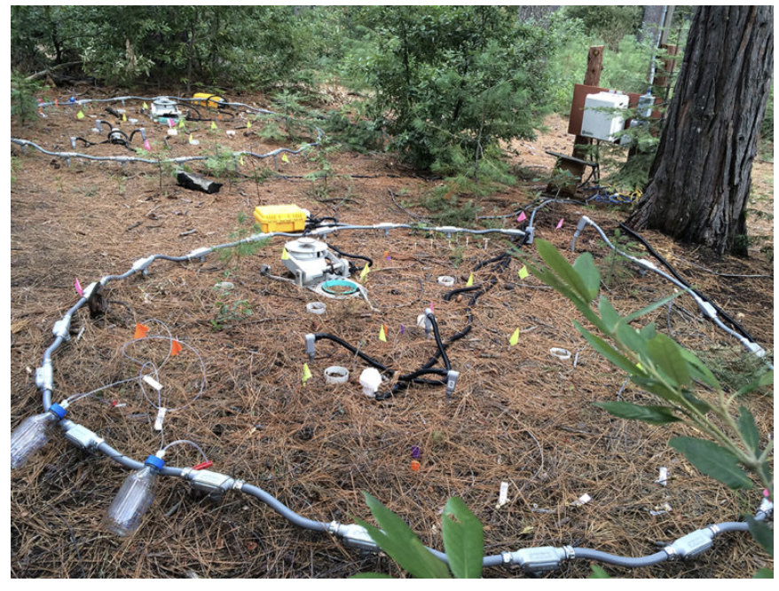
Active Warming methods
Infrared heaters
Heat-resistance cables

Slide 7
Deciding an appropriate warming methods
Several active and passive warming techniques each having their own strengths and weakness
Experimental and logistical limitations, cost of establishment and maintenances etc.
Selecting warming methods
Question of interest (responses to be measured)
Ecosystem
Availability of human and capital resources

Slide 8
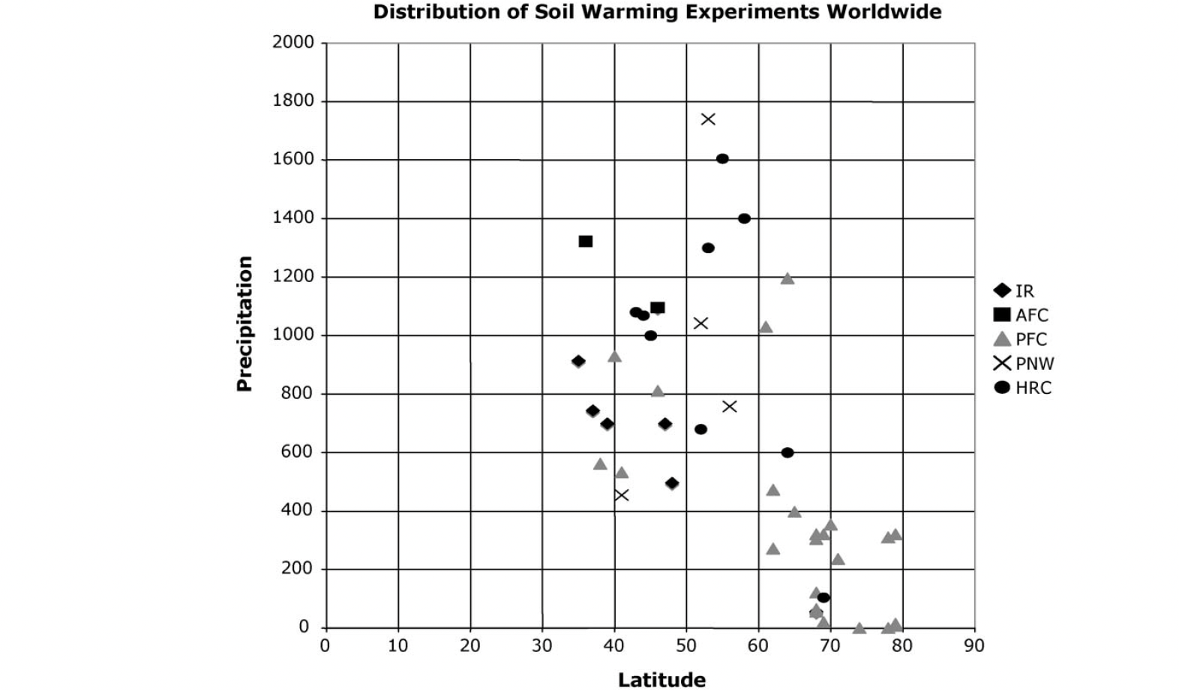
Worldwide distribution of soil warming experiments

Slide 9
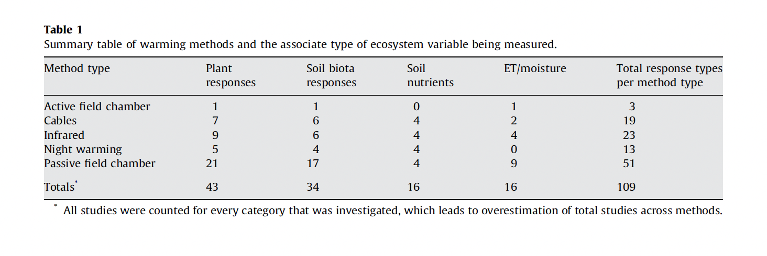
Response variable across methods

Slide 10
Cost Comparison
Vary considerably, even with same method depending on the level of automation.
Curtain = $4 m⁻²
OTC = $65 m⁻² year⁻¹
IR heaters = $ 80 – 260 m⁻² year⁻¹
Heating Cables = > $500 m⁻² year⁻¹

Slide 11
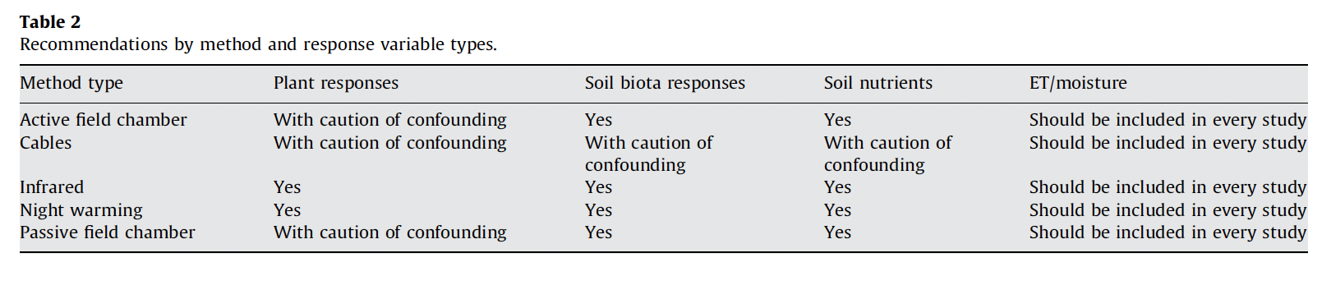
Conclusion & Recommendations:

